Slide 1
AIDI - 1100 - 02
INTRODUCTION TO AI DEVELOPMENT
Jugnu Shefin (100814025)
Esra Ersoy (100812358)
Abhishek Joshi (100820424)
Dheeraj Savanthy (100846124)
Akash Patel (100838052)
FINAL PROJECT
GROUP #3

Slide 2
AGENDA
Scan/Parse
Track/Store/Search
Retrieve stock price
Visualize
Conclusion

Slide 3
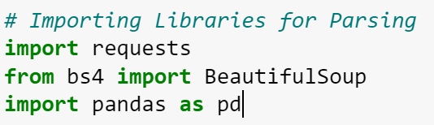
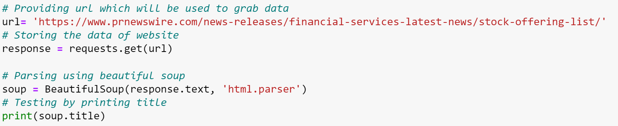
Scan/Parse
Scanning and Parsing of Data are conducted
with the use of Beautiful Soup Library.
The Data fetched from the URL is stored
in a variable called Soup.

Slide 4
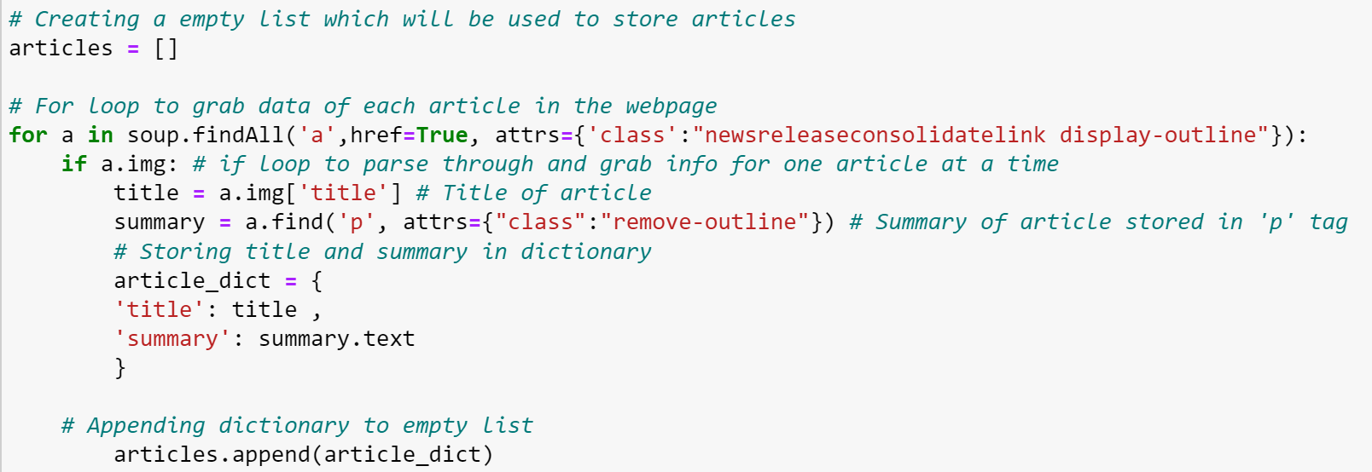
Track/Store/Search
TRACK
The Data is Tracked using html attributes. Mainly image title and paragraph.
To Track the data find() function is been used.

Slide 5
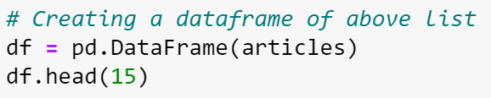
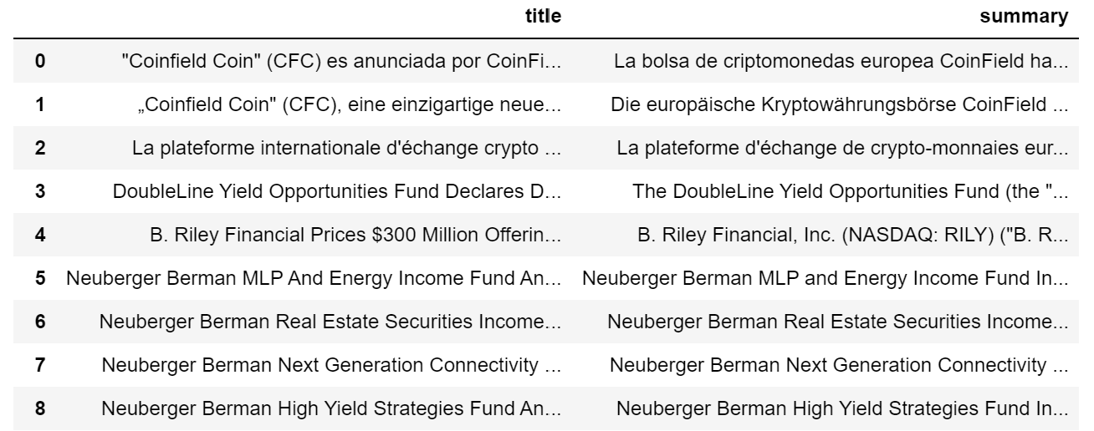
Store
Track/Store/Search
The Data fetched from the URL saved in List
named Articles is now Converted into a
DataFrame for more convenience

Slide 6
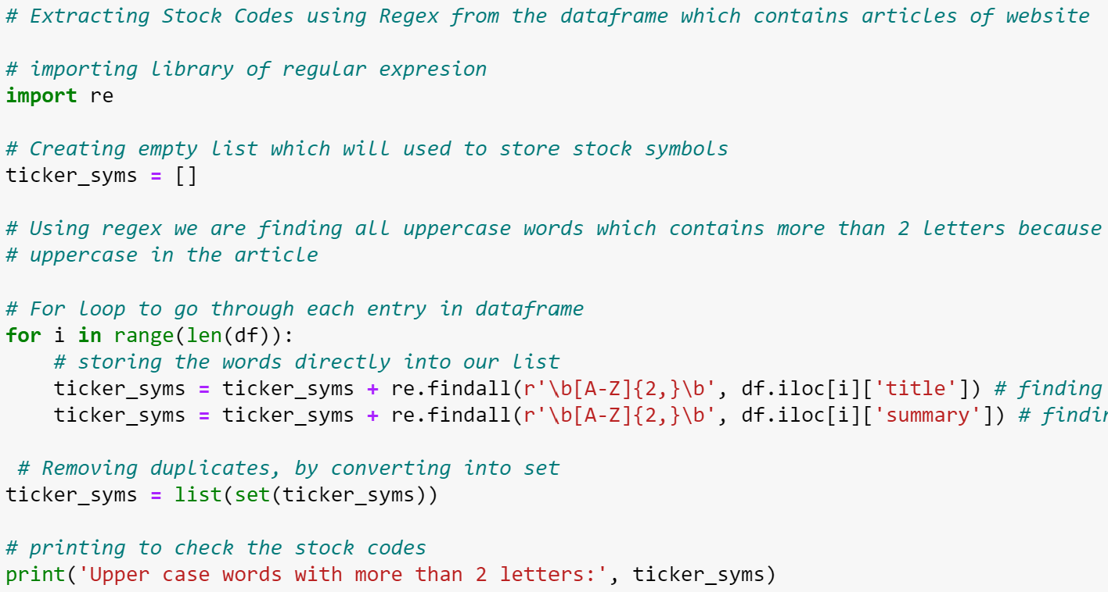
SEARCH
Track/Store/Search
Different Stock Symbols are Searched into the File using Regular Expression.
The findall() function is used to locate different
tickers
The Symbols are then stored in a list

Slide 7
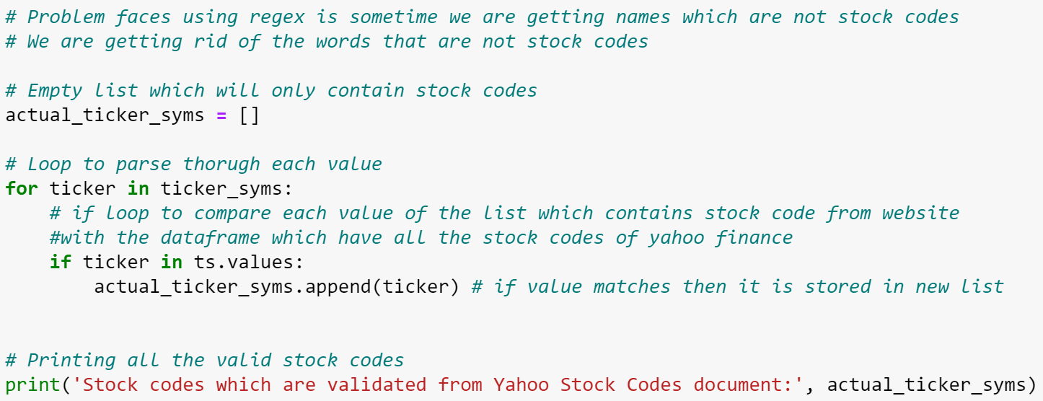
CONTINUE
While using REGEX to Locate Ticker Symbols we ran into a problem of getting different
Junk symbols which weren’t Stock Symbols.
So, to Eliminate those we Compare the Symbols with real Symbols fetched
from a reliable Source.(YAHOO Finance)

Slide 8

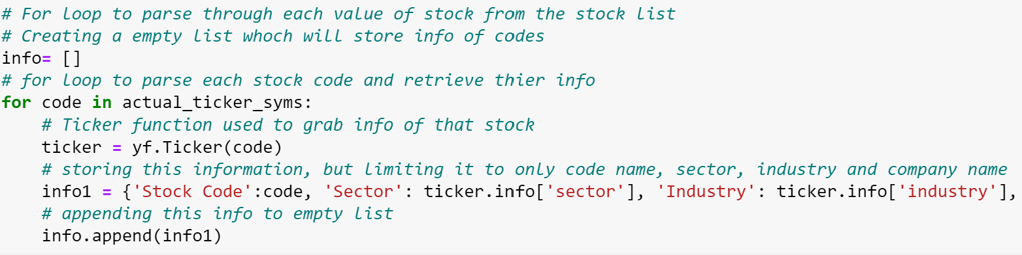
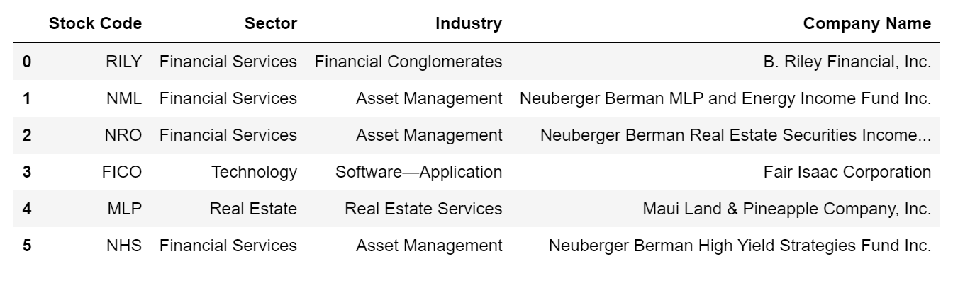
Retrieve stock price
Yahoo yfinance library is been used to
retrieve stock Data.

Slide 9
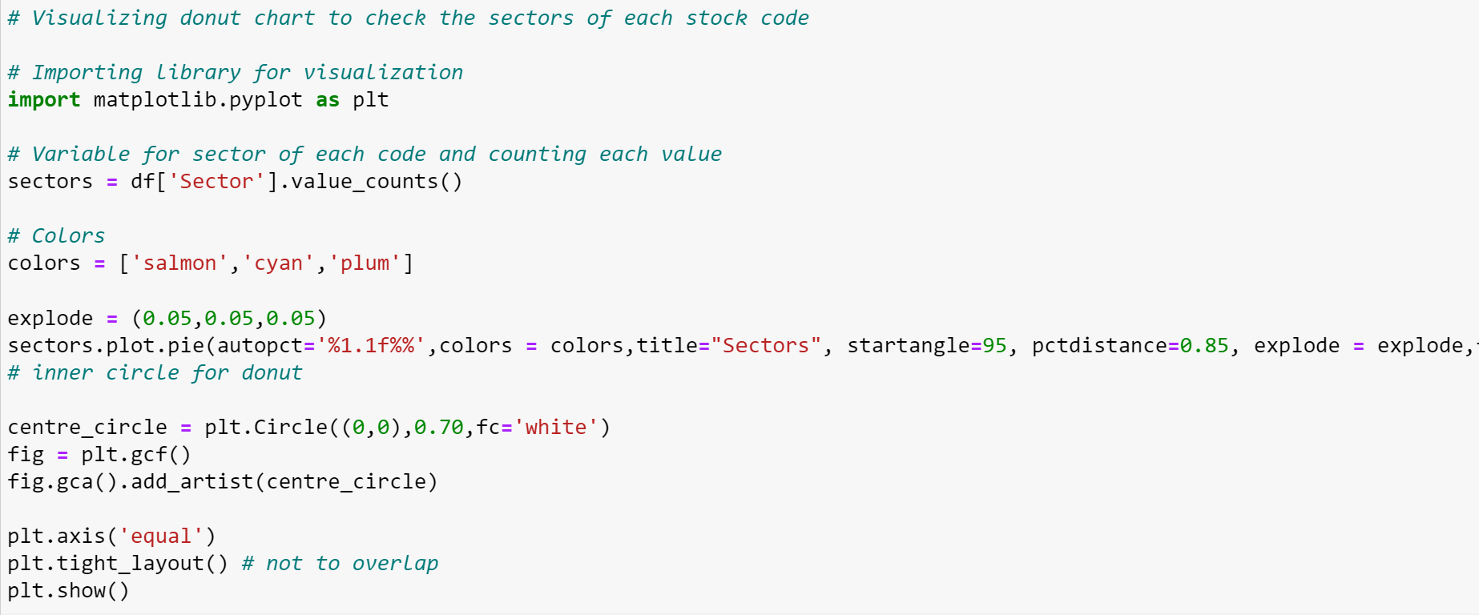
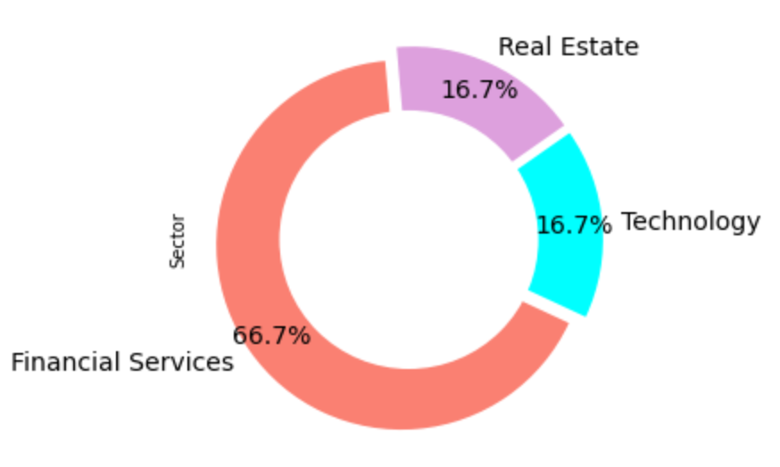
Visualizations
Here, The Donut Chart Shows what percentage of stocks
belongs to what Sector respectively.

Slide 10
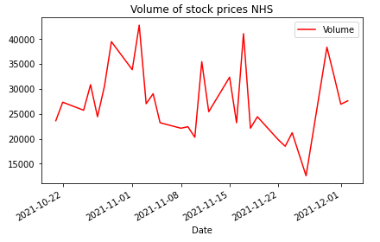
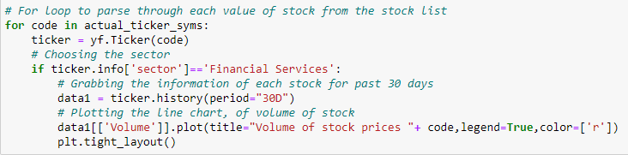
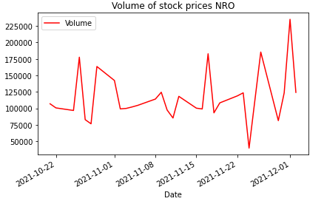
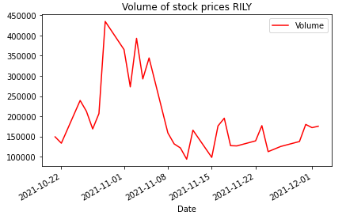
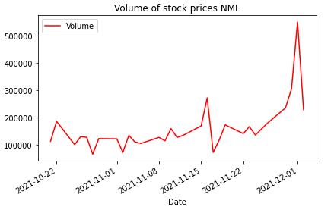
Visualizations
Here, The Using a for loop the graph for history of 30days of the stock list is shown.

Slide 11
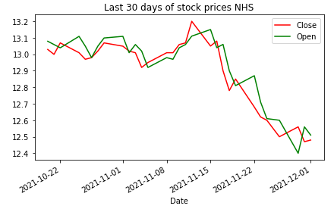
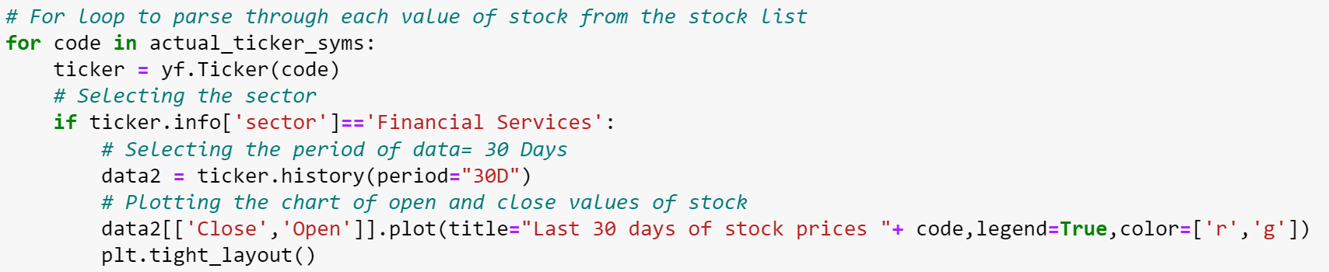
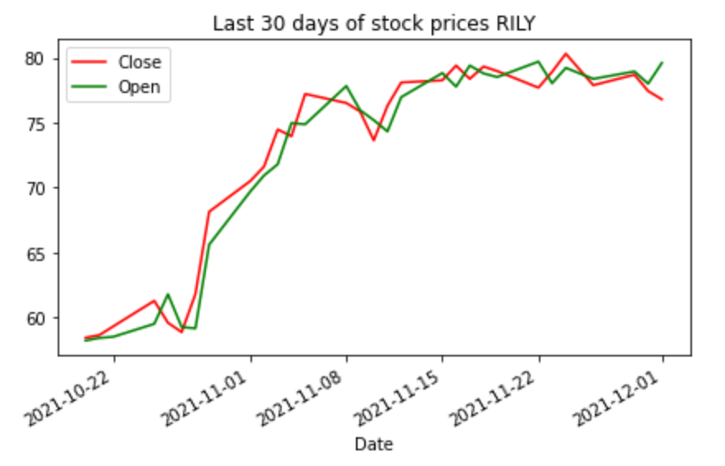
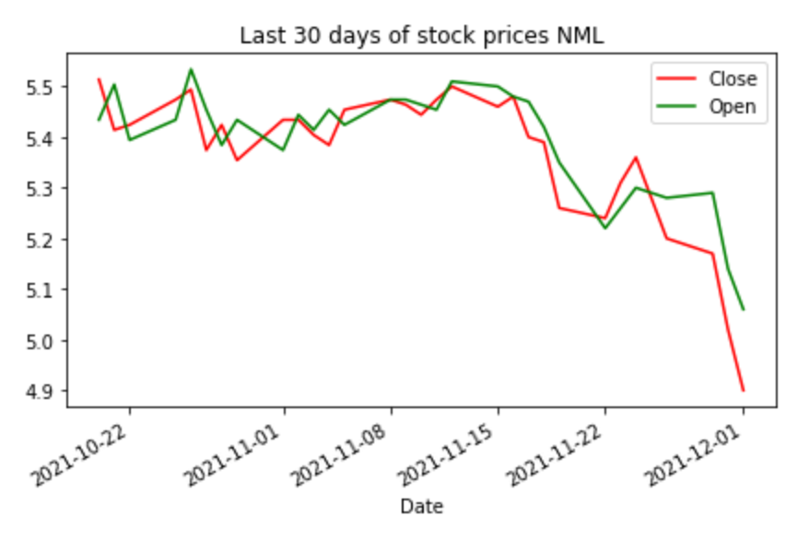
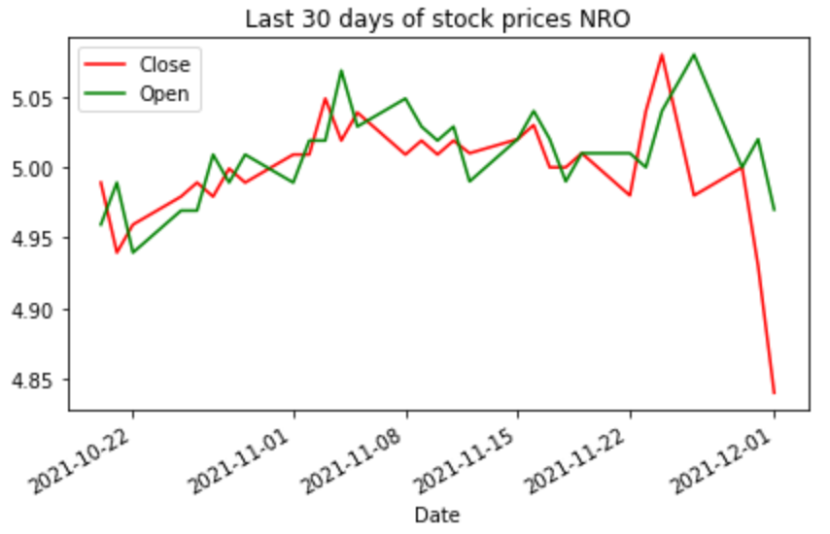
Visualizations
Here, Using a graph open and close history of stock for the last 30 days is shown.

Slide 12

Conclusion
As per the data of past 30 days of stocks NHS, NRO, RILY and NML. The visualization shows that most of the stocks value is depreciating except RILY. At the starting it was around 60$ but at this time it is around 80$. If anyone wants to invest some money then RILY will be a good choice.
More Info about RILY: https://finance.yahoo.com/quote/RILY/
GitHub Link:
https://github.com/dheerajsavanthy/AIDI_1100_INTRODUCTION_TO_AI_FINAL_PROJECT

Slide 13
Thank you
ANY QUESTIONS?

